Slide 1
AI Job Assistant
Full Stack Design Presentation
By: Lalith Aditya Chunduri

Slide 2
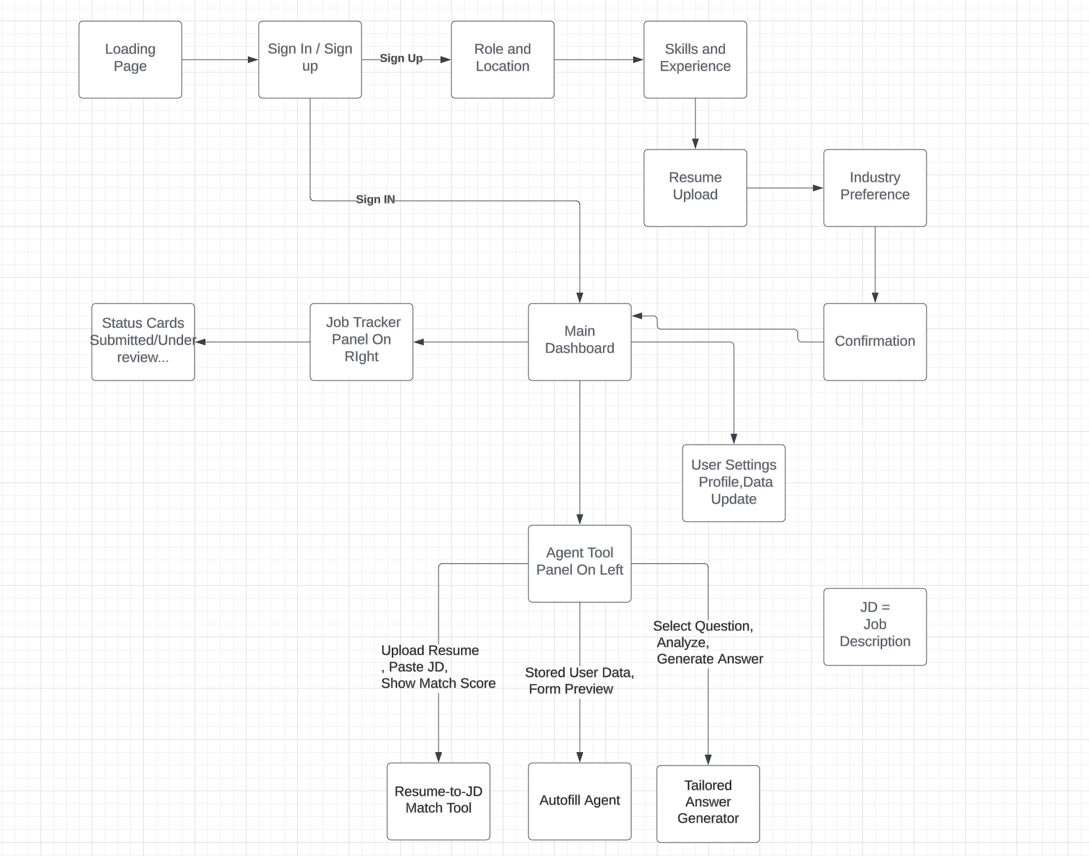
User Flow Diagram

Slide 3
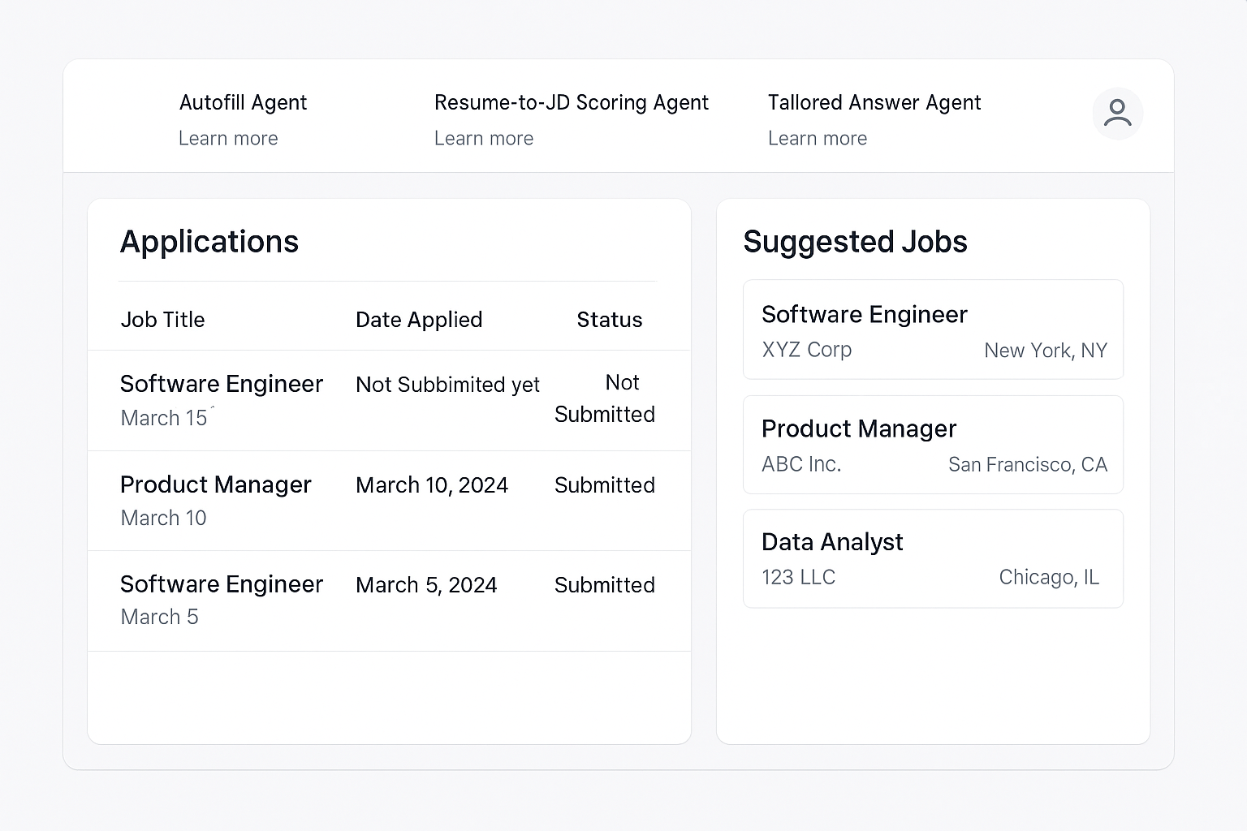
Dashboard Wireframe

Slide 4
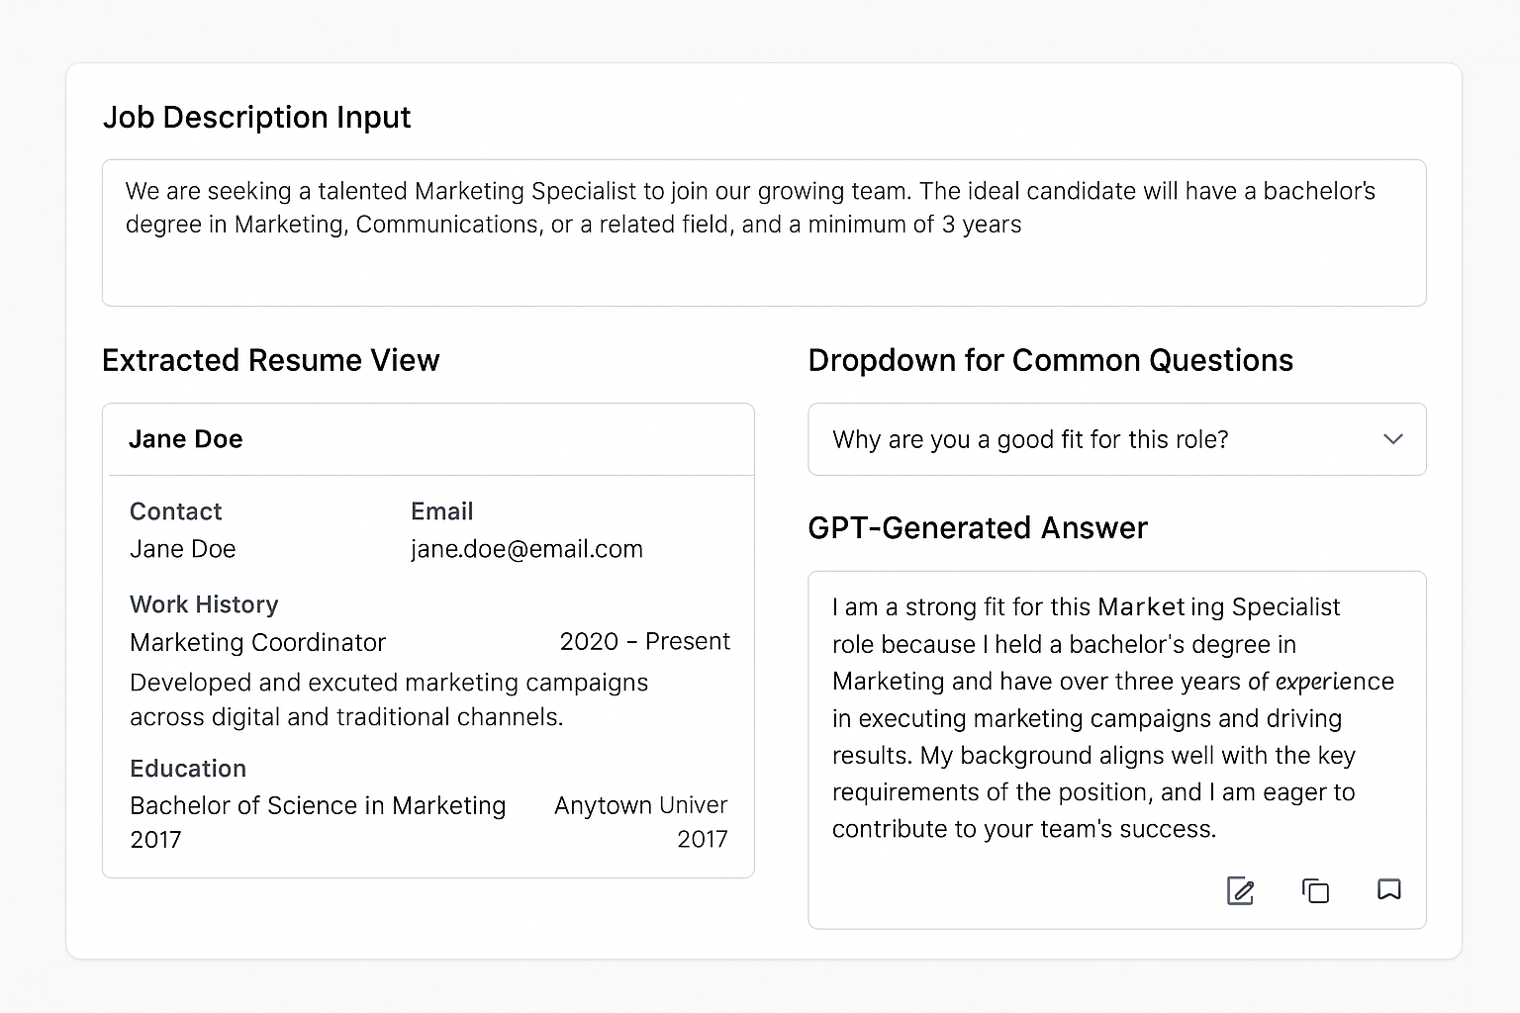
Tailored Answer Generator Wireframe

Slide 5
Agentic UX Principles Applied
Memory → Autofill Agent remembers details
Perception → Resume Scanner understands JD
Reasoning → Tailored Answer uses logic
Agency → User directs and controls agents
Transparency → Users see how decisions are made
Control → Edit or reject AI suggestions

Slide 6
Frontend Challenges
Building trust in AI answers
Parsing diverse resume formats
Managing GPT response latency
Standardizing autofill across job sites
Ensuring data security and privacy

Slide 7
Backend Design Goal
Objective:
Build a secure, scalable backend architecture to support agent-driven operations for job applications.

Slide 8
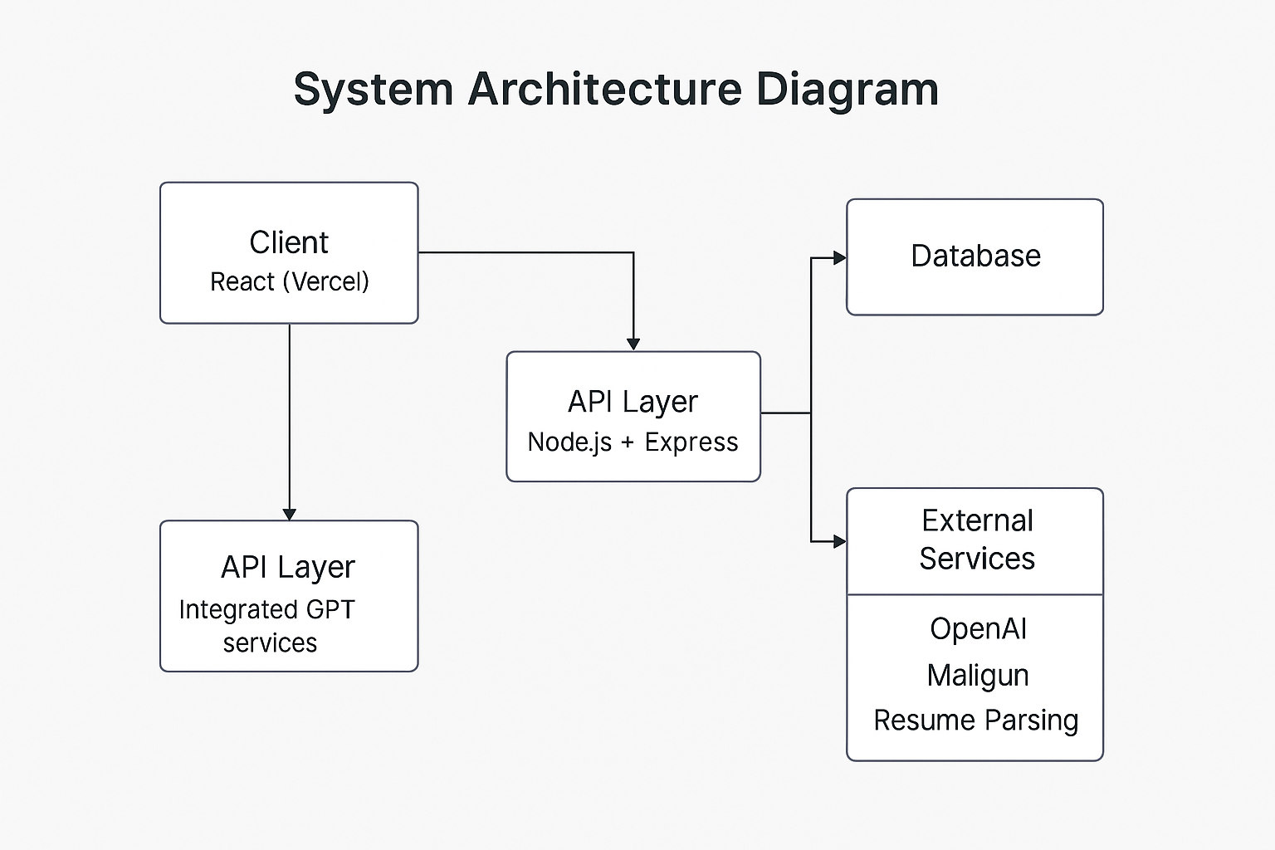
System Architecture Diagram
Notes:
the React frontend sends requests to the API layer, which either interacts with the database or forwards the data to external services. Results are returned to the user in real time, creating a seamless flow between interaction and AI support.”

Slide 9
Deployment & Logging Plan
Deployment Strategy:
Backend Dockerized and hosted on Render or AWS
Frontend deployed on Vercel
Logging & Monitoring:
Winston/Morgan for logs
Health checks via /status
Monitor uptime with UptimeRobot

Slide 10
📅 AI Job Assistant – 3-Week Timeline
Week | Milestone / Deliverables
Week 1 | - Research Agentic UX principles - Finalize core features - Start user flow diagram
Week 2 | - Design key wireframes (Onboarding, Dashboard, Tools) - Define backend architecture
Week 3 | - Prepare deployment/logging strategy - Finalize deliverables for office hours presentation

Slide 11
Office Hours Deliverables
Frontend:
✅ User Flow Diagram
✅ Wireframes ✅ Agentic UX Design Rationale
✅ UI/UX Challenge List
Backend:
✅ Architecture Diagram
✅ Agent-Integrated Flow
✅ Deployment with Docker
✅ Logging & Monitoring Tools

Slide 12
Thank You!
Questions?

